Slide 1
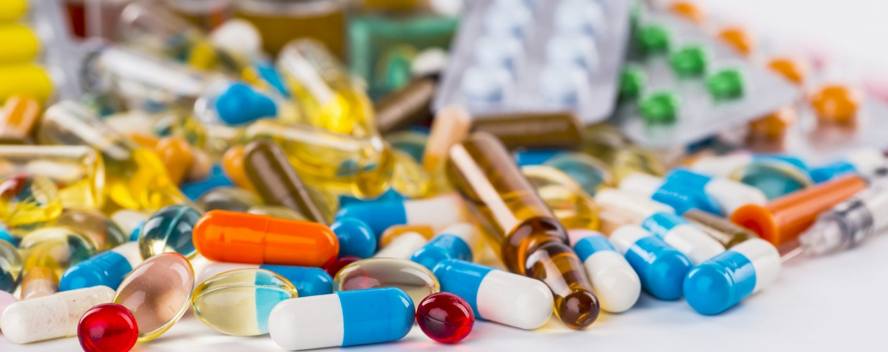
Removal of Pharmaceutical Compounds in Wastewater Using Microbial Fuel Cells
Reporter: Sahr Emmanuel (伊曼沙)
M202161014
Date: December 24, 2021

Slide 2
CONTENTS
Introduction
Why Microbial Fuel Cell
Triclosan Removal in MFC-Case Study
Configuration Materials and Methods
Result
Discussion and Conclusion

Slide 3
INTRODUCION
Phamaceuticals such as Antibiotics, anti-inflammatories, analgesics, beta-blockers, lipid regulators, and X-ray contrast media which can enter the water supply from a variety of sources, including pharmaceutical industry, hospital wastewater, landfill leachate leaks, human excrement, and so on (Archer et al., 2017) are known as Emerging Contaminants (EC).
These contaminant can:
induce aquatic toxicity,
weaken antibiotic resistance in bacteria,
endocrine disruption, and genotoxicity.
can accumulate in living organisms.

Slide 4
why microbial fuel cells?
ozonation
membrane filtration
adsorption
UV-H2O2 treatment
membrane biological reactors
Because secondary biological processes are unable to remove pharmaceuticals, tertiary treatments are used in WWTPs to remove them.
Notes:
However, every approach has drawbacks. For example, in ozonation treatment, by-products of parent pharmaceuticals are generated, creating a longer treatment period for complete degradation of these pollutants (Alharbi et al., 2016). Aside from that, membrane filtration has high operational expenses, and electrochemical approaches require external power (Ahmad et al., 2020; Zaied et al., 2020). As a result, a new technique is needed that can meet the demand for pharmaceutical removal at a low operating cost without the use of external chemicals.

Slide 5
why microbial fuel cells?
Microbial fuel cell (MFC) technology offers tremendous potential in this area, as it has the ability to remove pharmaceuticals from wastewater while also creating bioelectricity.
Pharmaceuticals can be successfully eliminated in both anodic and cathodic chambers of an MFC.
The anodic chamber permits these pollutants to be oxidized, whereas the cathodic chamber uses reduction mechanisms (Kumar et al., 2018; Wang et al., 2017b).

Slide 6
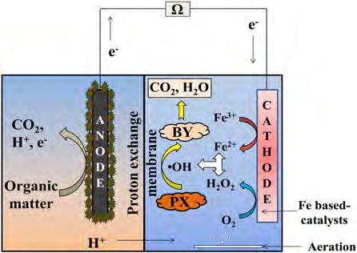
Mechanism
The electrons move to cathode via external circuit, while the protons pass through the Proton Exchange Membrane (PEM) to cathode.
At the cathode, electrons coming from anodes, protons coming through the Proton exchange membrane, and oxygen from the air combine to generate water. During the processes, not only electrons are extracted from the organic wasted but the wastes (BOD) is removed as well.
This process requires no net energy input as these reactions are thermo dynamically favorable.
Many researchers across the world have been studying the application of Microbial Fuel Cells for wastewater treatment where bacterial cluster in the anode chamber anaerobically degrade the organic materials present in the wastewater to release electrons to the anodic rod and protons into solution.
Figure 1 Process of bio-electro-Fenton. (PX: pharmaceuticals, BY: intermediate by-products.)

Slide 7
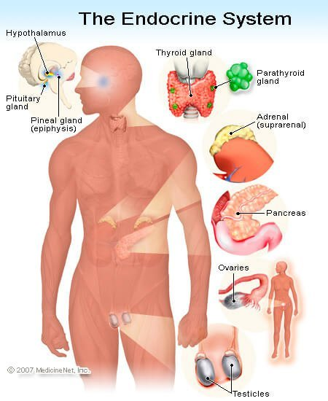
case study
Triclosan Removal in MFC by Wenli Xu, Biao Jin, Shaofeng Zhou
Triclosan [5-chloro-2-(2,4-dichlorophenoxy) phenol, TCS] is a common antibacterial agent used in various personal care products. Due to their high assumption volume, TCS can occurs as a water pollutant in domestic wastewaters as well as natural aquatic environments.
The occurrencesof TCS in the environment have raised great concern due to its endocrine disrupting effects
Objective:
examine TCS elimination efficiency using MFC.
analyze TCS attenuation and power generation in MFC

Slide 8
Configuration Materials and Methods
A two-chambered MFC was made of polycarbonate materials, consisting of an anode chamber and a cathode chamber. There was a cation exchange membrane between the two chambers. A graphite fiber brush was used as the anode and graphite plate was used as the cathode. Titanium wires were used to connect the circuit with an external resistance of 1000 ohms.
The concentration of TCS was determined using gas chromatography coupled with mass spectrometry.
Voltages across the resistance were measured using a digital multimeter and data were automatically recorded by a data acquisition system.
The current was calculated according to Ohm’s law (I = V/R). The current density was obtained by dividing the current by the total surface area of the anode.
Polarization and power density curves were obtained by varying the resistance in a range from 10 to 10,000 Ω by using the data acquisition system.
e⁻
e⁻
Glucose
H⁺
MEDnd
e⁻
H₂O
e⁻
MED^{DX}
CO₂
O₂
H⁺
H⁺
Anode
Bacterium
Membrane
Cathode

Slide 9
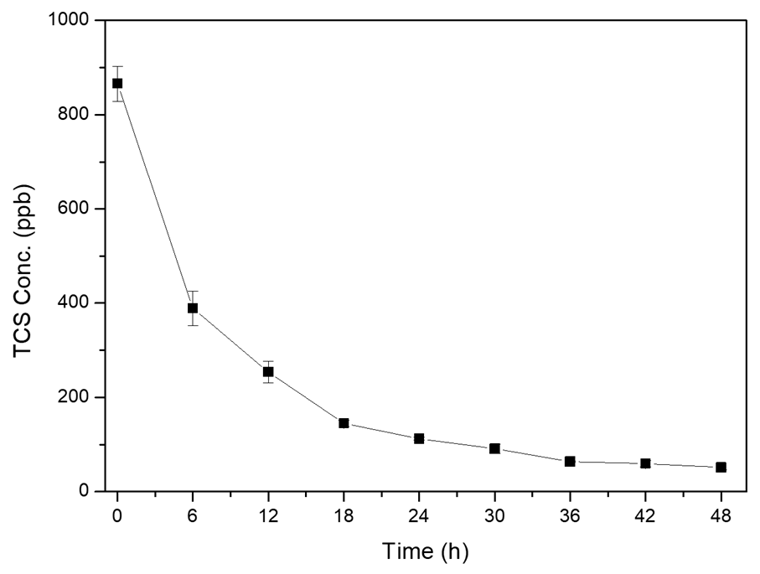
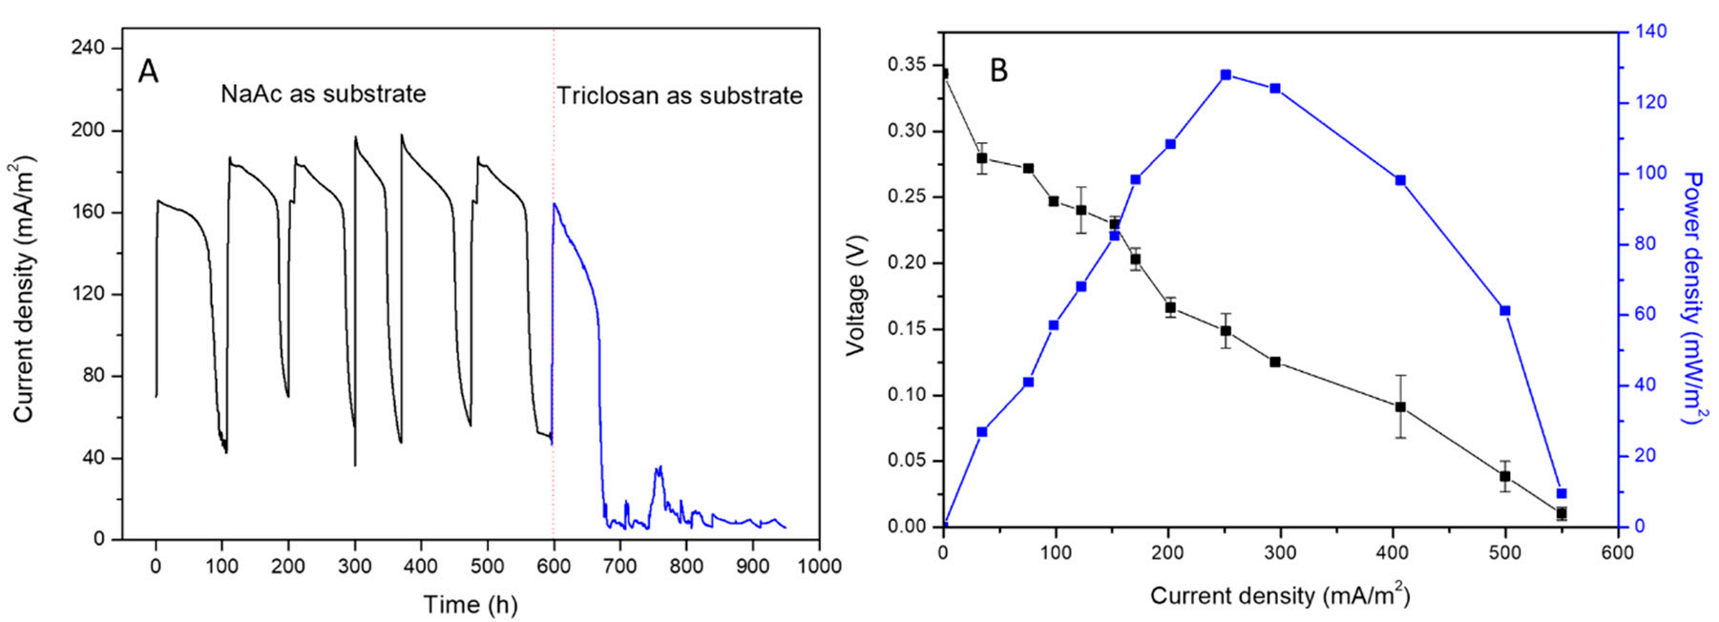
Result
Fig 2. Reduction of Triclosan (TCS) aqueous concentration at pH 7.
Figure 3. The profile of current generation (A) The profile of current density with NaAc or TCS feeding (B) Polarization curve and power density
Notes:
Figure 2 shows the aqueous concentration profile of TCS in the MFC reactor. A significant reduction in TCS in the aqueous phase was observed, where most TCS (94%) was removed within 48h. The results also indicate possible TCS degradation in the MFC environment.
The output current density of the MFC correlated with the metabolism activity of microbes in the system (Figure 3A). After sludge was inoculated into anode chambers, the current density fifirst reached 160 mA/m2 within 7 days, further increasing to 170 mA/m2, and the signals dropped and recovered in the several following cycles (every cycle is about 100 h). The steady current density output reflflects that the MFC was successfully initiated. However, right after adding 1 mg/L TCS to replace sodium acetate, the highest output current density of the MFC fifirst went up to 160 mA/m2. This might be partly due to the consumption of the remaining NaAc in the system. In the following five cycles, the output current density dropped significantly, which could be due to limited substrate availability at low TCS concentrations.
The electrochemical activity of the MFC was calculated by a polarization curve and a power density curve (see Figure 3B), which was obtained in the steady state when feeding with TCS. Figure 3B showed the maximal power densities of 120 mW/m2 at a current density of 260 mA/m2. The open circuit voltage (OCV) was 0.35V (when the current density was 0). The voltage showed a decreasing trend with the increase in current density. These results revealed that the MFC was in an active state.

Slide 10
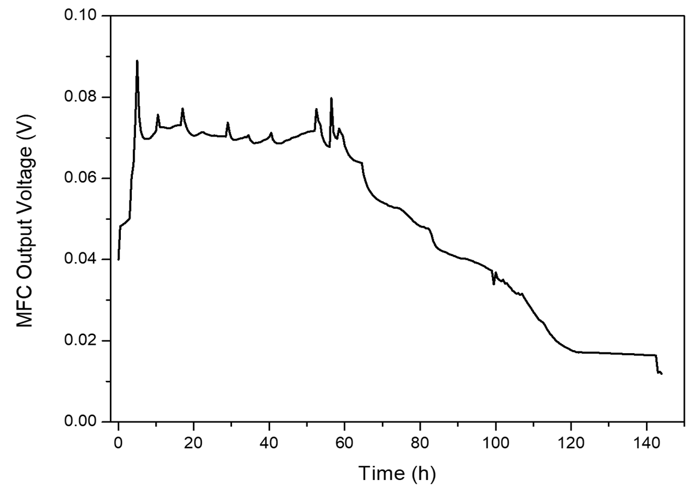
Results
The maximum output voltage was 70-80 mV (19.4-26.7 mA/m2) for 40 hours with a TCS concentration of 10 mg/L and an external resistance of 1000. The maximum voltage obtained was lower than using NaAc as feeding substrate (see Figure 3A). This could be because there isn't enough of the substrate at such a low concentration of TCS.
The results in this figure were collected several batch runs following (about 400 h) the batches in Figure 3A. Thus, it proves that the bacteria in the anode chamber can still remove TCS and produce electricity after several batches.
Figure 4. The electricity generation during bioelectrical treatment of TCS.

Slide 11
Discussion and Conclusion
A significant reduction in TCS in the aqueous phase was observed, where most TCS (94%) was removed within 48h. The results also indicate possible TCS degradation in the MFC environment.
TCS was also removed by both physical adsorption and biodegradation. TCS adsorption occurred on the reactor inner wall as well as the anode electrode, contributing 21.73% and 19.92%, respectively.
Along with TCS adsorption, electrochemical biodegradation successfully eliminated TCS in aqueous solution, producing power at 70-80 mV. They deduced that MFC removes TCS effectively by combining microbial and electrochemical activities.
In conclusion, generally physical processes and factors like adsorption, Type of Electrodes, substrates concentration, types of microbes, and proton membrane
are crucial for pharmaceuticals elimination in Microbial Fuel Cells and so require rigorous characterization and investigation are required.

Slide 12

Thank You

Slide 13
Reference
Xu, Wenli, Biao Jin, Shaofeng Zhou, Yanyan Su, and Yifeng Zhang. "Triclosan Removal in Microbial Fuel Cell: The Contribution of Adsorption and Bioelectricity Generation." Energies 13, no. 3 (2020): 761.
Shah, Maulin P., ed. Removal of Refractory Pollutants from Wastewater Treatment Plants. CRC Press, 2021.
Gracia-Lor, Emma, Juan V. Sancho, Roque Serrano, and Félix Hernández. "Occurrence and removal of pharmaceuticals in wastewater treatment plants at the Spanish Mediterranean area of Valencia." Chemosphere 87, no. 5 (2012): 453-462.
Archer, Edward, Bruce Petrie, Barbara Kasprzyk-Hordern, and Gideon M. Wolfaardt. "The fate of pharmaceuticals and personal care products (PPCPs), endocrine disrupting contaminants (EDCs), metabolites and illicit drugs in a WWTW and environmental waters." Chemosphere 174 (2017): 437-446.
Wang, Bing, Bin Gao, and June Fang. "Recent advances in engineered biochar productions and applications." Critical reviews in environmental science and technology 47, no. 22 (2017): 2158-2207.

